Slide 1
Topic 8
Software Testing
Part 3

Slide 2
Functional Testing
• Structural testing – white box
– test as much of path coverage as possible
– can only test code that exists
• may have missed several requirements
• but can still achieve high coverage
• Functional testing – black box
– Make sure the code meets the requirements

Slide 3
Functional Testing
• Must consider unstated requirements
– like error handling
– ease of use
• Ideally, we should go through all requirements systematically and develop tests for them
– Standard methods of doing so exist

Slide 4
Functional Testing Example
• Triangle Analyzer Requirements
– Program prompts user for input
– User enters three real numbers, separated by commas
• e.g. 2.5, 6, 6.5
– Program responds with:
• Equilateral: sides define equilateral triangle
• Isosceles: likewise
• Scalene: likewise
• Not a triangle: no valid triangle with those side lengths
– (e.g. 3, 4, 1000 since 3 + 4 >= 1000 [triangle inequality])

Slide 5
Functional Testing Example
• What tests cases will we use?
– These will be functional (black-box) test cases, since we are working only from the requirements

Slide 6
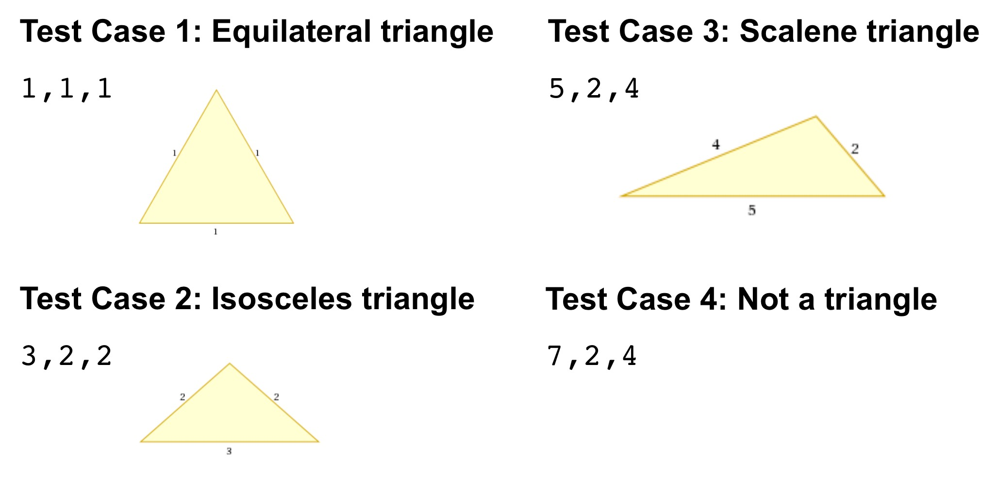
Functional Testing Example

Slide 7
Functional Testing Example
• Probably want to test with all possible combinations of each test as well
– (2,4,5) (2,5,4) (4,2,5) (4,5,2) (5,2,4) (5,4,2)
• Need to consider unstated requirements as well:
– Invalid input characters: 1, a, 2
– Invalid number of inputs 1, 2
– Invalid input format: 1 2 3
– etc.

Slide 8
Functional Testing
• How to choose good functional test cases?
• We will look at each of the following :
– Test all possible outputs
– Test both valid and invalid inputs
– Test around boundaries
– Test extreme values
– Test input syntax
– Guess at possible errors

Slide 9
Functional Testing
• These techniques will generate lots of test cases
– A test case may be one input, or a sequence of inputs (depending on the program)
– Often more test cases for erroneous input than for valid input (unhappy paths)

Slide 10
Test all possible outputs
• For each possible output specified
– Write a test case that will produce that kind of output
• Examples:
– Triangle analyzer
• One case for each of Equilateral, Isosceles, Scalene, and Not a Triangle
– Parking garage simulator
• A case for parking a car; one for retrieving a car
• Should also have cases for garage full and no such car

Slide 11
Test valid and invalid inputs
• Often, an individual input x to a program has:
– A valid range like x>=0, or 1<=x<=12
– valid set of values
• x is a string of alphanumeric characters
• x ∈ {red, green, blue}
• Inputs outside these ranges/sets are invalid.
• For each input to the program:
– Test at least one valid value
– Test at least one invalid value
– Test invalid values near boundaries of range (-1 and 13)

Slide 12
Test valid and invalid inputs
• Individual inputs to a program can include:
– Things types in to a console or a GUI control
– Command-line options
– Values in configuration files
– etc.
• Examples of invalid inputs:
– Triangle analyzer: Test -1 or Z as the length of a side
– Day planner program: Enter Jqx as the name of a month

Slide 13
Testing near boundaries
• Failures often occur close to boundaries
– Boundaries between different kinds of output
– Boundaries between valid and invalid inputs
• Such failures are often due to faults such as
– Errors in arithmetic
– Using <= instead of <
– Not initializing a loop properly
We should test at and/or around boundaries

Slide 14
Test boundaries
• Triangle analyzer
– Test case: 2, 2, 4.00001 (almost, but not a triangle)
– Test case: 2, 2, 4 (right on boundary)
• Pop machine dispenser software:
– If the user has exactly enough money to buy a can it should be dispensed
• but does not require change
• If the program erroneously contains a test like:
– if (balance > cost)
– this will not be allowed (since the test should be >=)
– Here, a boundary test will find and test this situation

Slide 15
Test extreme values
• Software may not handle very large or very small values correctly due to things like
– Buffer or arithmetic overflows
– Mistaken assumptions that a string will be non- empty
• These can easily crash a program

Slide 16
Test extreme values
Examples:
• With just about any program that accepts user input:
– Empty strings
– Very long strings
Ex. Triangle analyzer:
4321432134, 543234344, 6566765888 (very large)
0.00000003, 0.00000008, 0.00000005 (very small)

Slide 17
Test input syntax
– Something omitted: 5, 12 13 (comma missing)
– Too few/many values: 5, 12 or 5, 12, 13, 20
– Invalid tokens: 5, 12, qwe
• In these situations
– Program should not just crash
– Give informative error message, and recover if possible
– Do not just accept and process as if correct
• Ex. for too many inputs: just process the first 3 valid ones (undesirable)
• can be even worse than just crashing, as user does not know what is happening
– Do not silently deny
• let user know what is happening

Slide 18
Guess at faults
• Finally, use intuition to think of how a program
might be wrong:
– Might be better to get person A to think of possible faults in person B's code
• Example with the triangle analyzer:
– To see whether a triangle is isosceles, the code must test all three distinct pairs amongst the three numbers for equality:
– What if not all three pairs have been tested by the code?
– Thus, test all of 2,2,3; 2,3,2; and 3,2,2

Slide 19
Functional vs. Structural Testing
• Functional (black-box) testing
– Advantages
• Ensures program meets requirements
• Test boundaries, etc., explicitly
– Disadvantages
• Cannot test undocumented features
• May not test hidden implementation details thoroughly

Slide 20
Functional vs. Structural Testing
• Structural (white-box) testing
– Advantages
• Tests all code and implementation details
• Coverage metrics can give us an idea of the extent to which our code is tested
– Disadvantages
• Cannot test whether all desired features are implemented
• We saw how 100% statement coverage essentially means nothing in relation to code quality / correctness

